Slide 1
Front-End Developer 20 – 26.03.2018
Sinisa Vrhovac

Slide 2
Sadržaj časa
CSS

Slide 3
Ponavljanje je majka znanja ☺

Slide 4
Sta je CSS?

Slide 5
Sta je CSS?
Istorija
Namena
Relacija sa HTML i js
Sintaksa
Notes:
https://www.w3.org/Style/CSS/
The CSS 1 specification was completed in 1996. Microsoft's Internet Explorer 3[19] was released in that year, featuring some limited support for CSS. IE 4 and Netscape 4.x added more support, but it was typically incomplete and had many bugs that prevented CSS from being usefully adopted. It was more than three years before any web browser achieved near-full implementation of the specification.
CSS 1: The first CSS specification to become an official W3C Recommendation is CSS level 1, published on December 17, 1996.
Among its capabilities are support for:
Font properties such as typeface and emphasis
Color of text, backgrounds, and other elements
Text attributes such as spacing between words, letters, and lines of text
Alignment of text, images, tables and other elements
Margin, border, padding, and positioning for most elements
Unique identification and generic classification of groups of attributes
The W3C no longer maintains the CSS 1 Recommendation.
CSS 2
CSS level 2 specification was developed by the W3C and published as a recommendation in May 1998. A superset of CSS 1, CSS 2 includes a number of new capabilities like absolute, relative, and fixed positioning of elements and z-index, the concept of media types, support for aural style sheets (which were later replaced by the CSS 3 speech modules)[39] and bidirectional text, and new font properties such as shadows.
The W3C no longer maintains the CSS 2 recommendation.
CSS 3: Unlike CSS 2, which is a large single specification defining various features, CSS 3 is divided into several separate documents called "modules". Each module adds new capabilities or extends features defined in CSS 2, preserving backward compatibility. Work on CSS level 3 started around the time of publication of the original CSS 2 recommendation.
The earliest CSS 3 drafts were published in June 1999.
Due to the modularization, different modules have different stability and statuses.

Slide 6
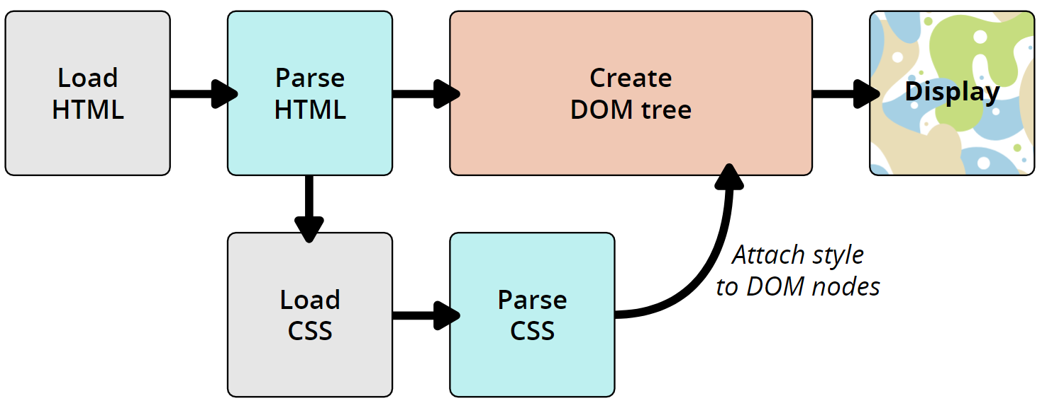
Kako CSS radi?

Slide 7
CSS Box Model

Slide 8
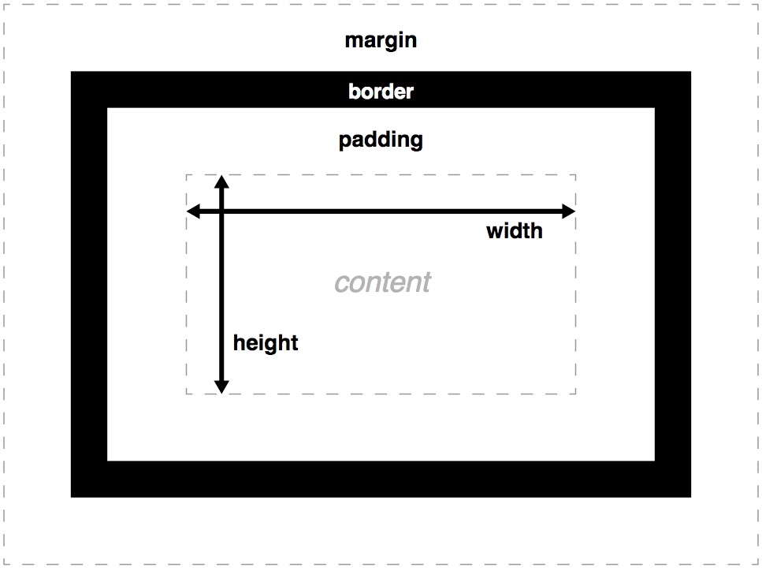
CSS Box Model
Notes:
A block box is defined as a box that's stacked upon other boxes (i.e. content before and after the box appears on a separate line), and can have width and height set on it. The whole box model as described above applies to block boxes.
An inline box is the opposite of a block box: it flows with the document's text (i.e. it will appear on the same line as surrounding text and other inline elements, and its content will break with the flow of the text, like lines of text in a paragraph.) Width and height settings have no effect on inline boxes; any padding, margin and border set on inline boxes will update the position of surrounding text, but will not affect the position of surrounding block boxes.
An inline-block box is something in between the first two: It flows with surrounding text and other inline elements without creating line breaks before and after it unlike a block box, but it can be sized using width and height and maintains its block integrity like a block box. It won't be broken across paragraph lines like an inline box. In the below example the inline-block box goes onto the 2nd line of text while keeping the shape of a box as there is not enough space for it on the first line, whereas inline box does break on multiple lines if there is not enough space — it loses the shape of a box.

Slide 9
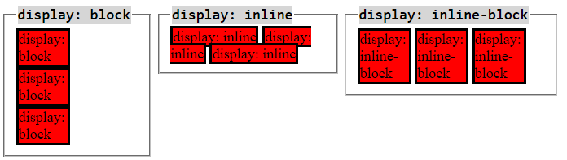
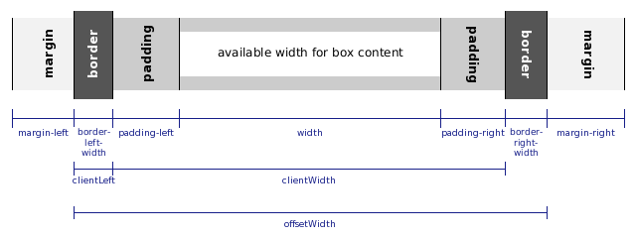
Box i inline elementi

Slide 10
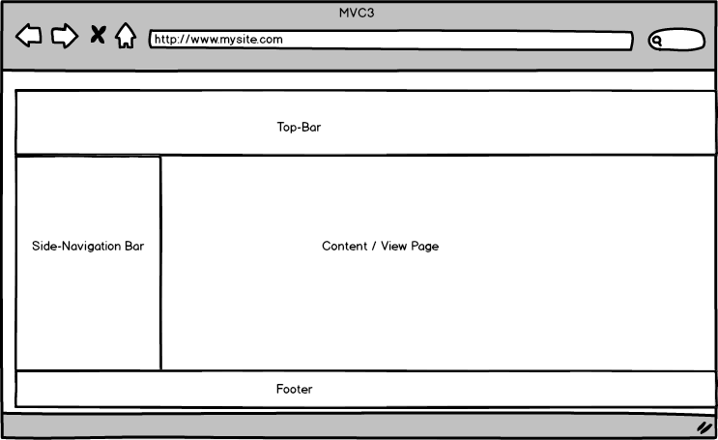
Pozicija i slaganje

Slide 11
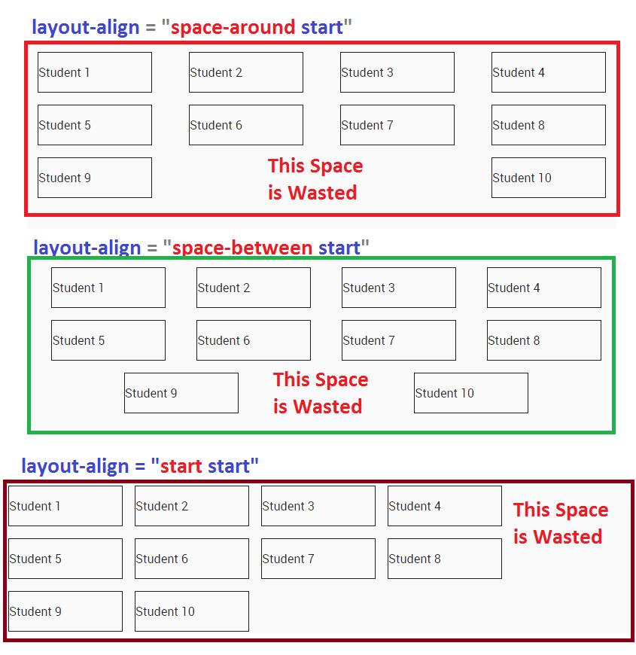
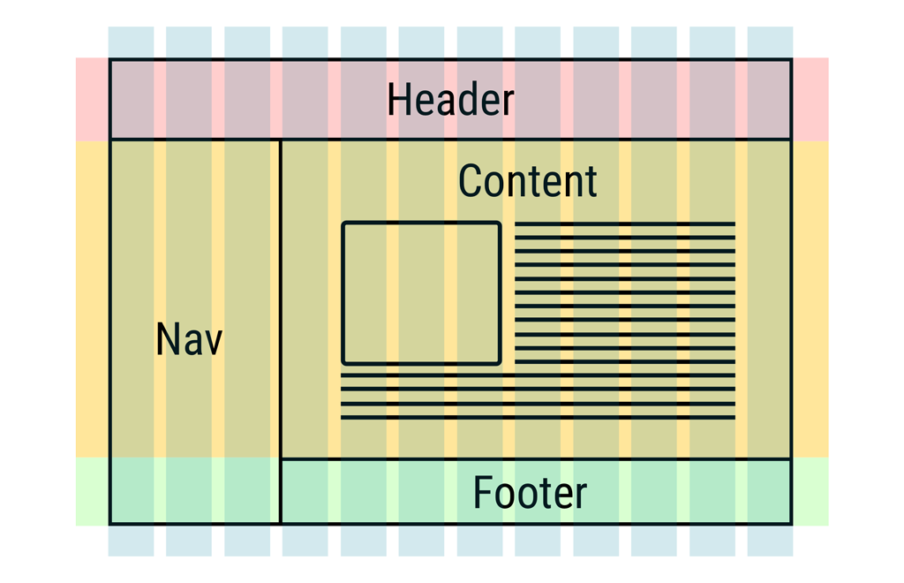
Pozicija i slaganje

Slide 12
CSS selektori

Slide 13
CSS selektori
ID
Class
Element
Ulancani selektori

Slide 14
Alati

Slide 15
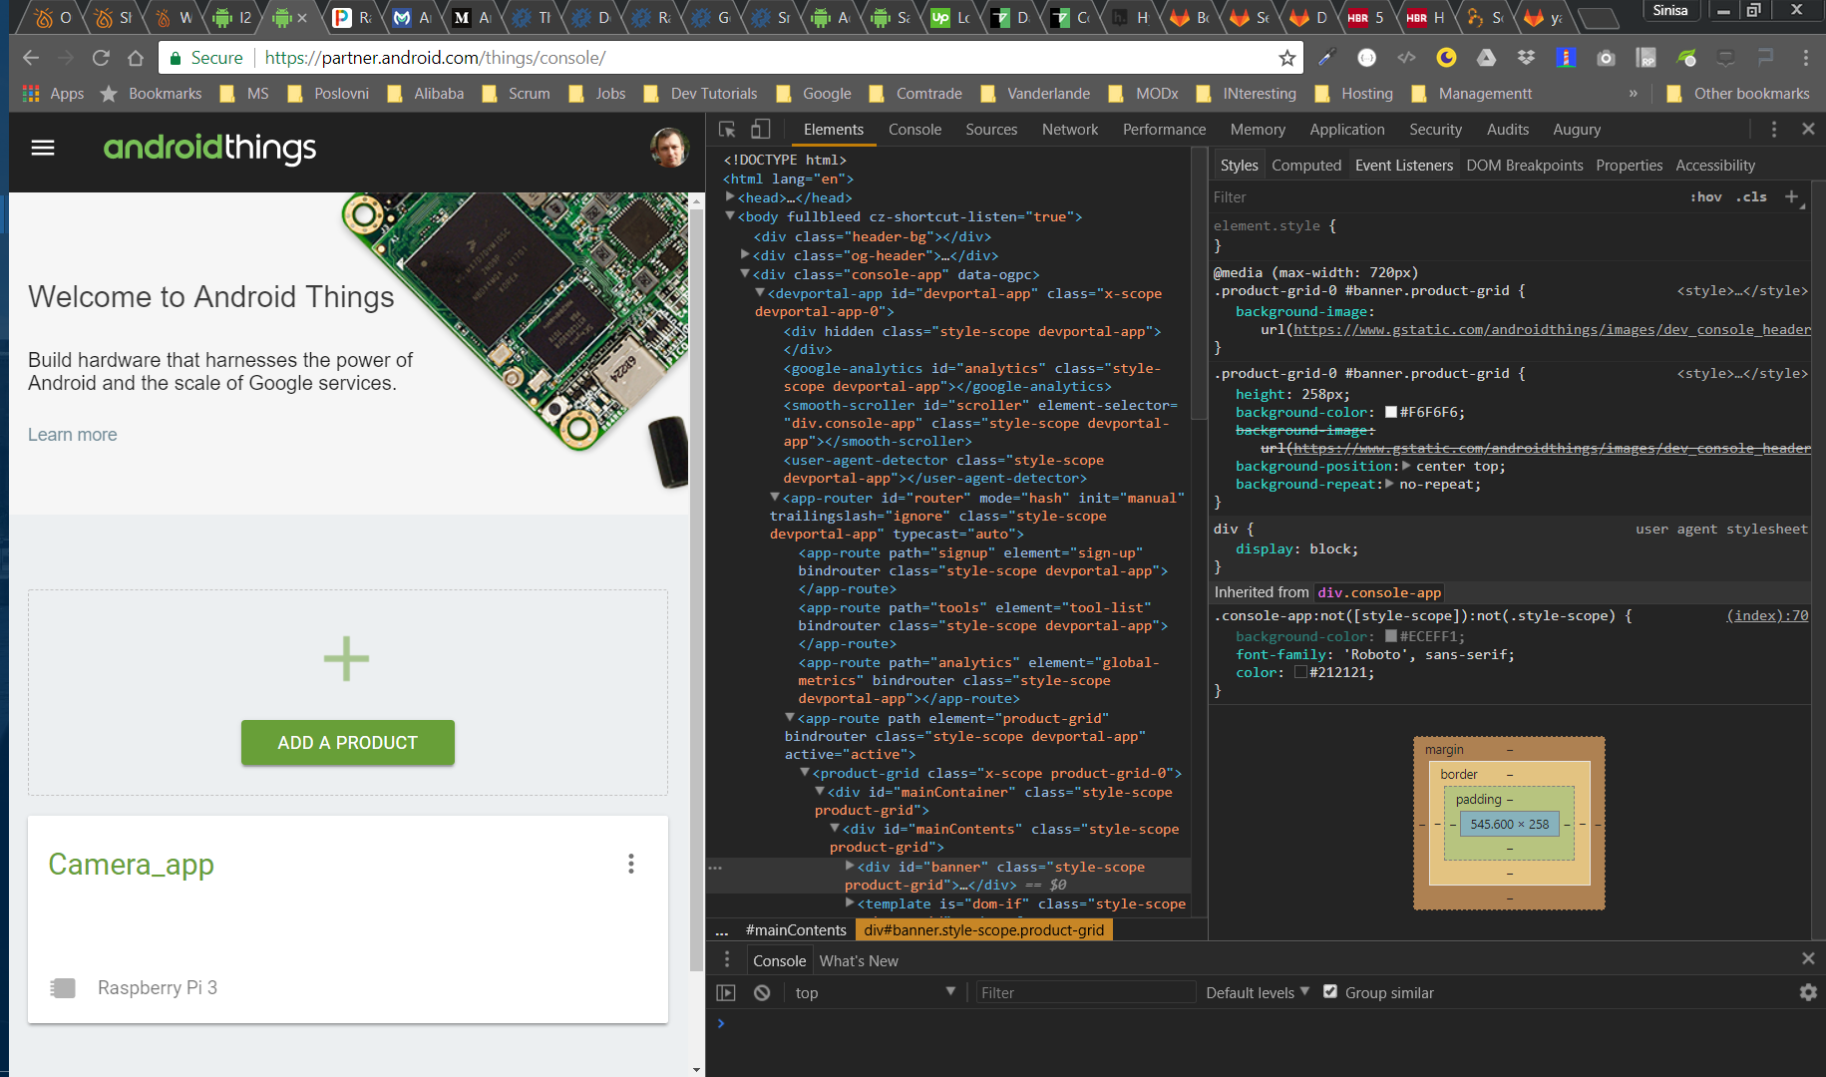
Google Chrome

Slide 16
Vezbe

Slide 17
Vezbe

Slide 18
Vezbe

